Slide 1




A SYSTEMATIC AND REPRODUCIBLE COMPARISON OF VISION TRANSFORMERS (VITS) AND GENERATIVE ADVERSARIAL NETWORKS (GANS) FOR BREAST CANCER SUBTYPE CLASSIFICATION IN HISTOPATHOLOGY
Nima Osman

Slide 2
01.
CURRENT CHALLENGES
02.
GAPS IDENTIFIED
03.
RESEARCH OBJECTIVES
04.
PROPOSED METHODOLOGY AND DATA SELECTION
05.
TIMELINE AND ANTICIPATED OUTCOMES
OUTLINE
06.
ETHICAL CONSIDERATIONS

Slide 3
INTRODUCTION
The challenge and opportunity in Computational Histopathology

Slide 4
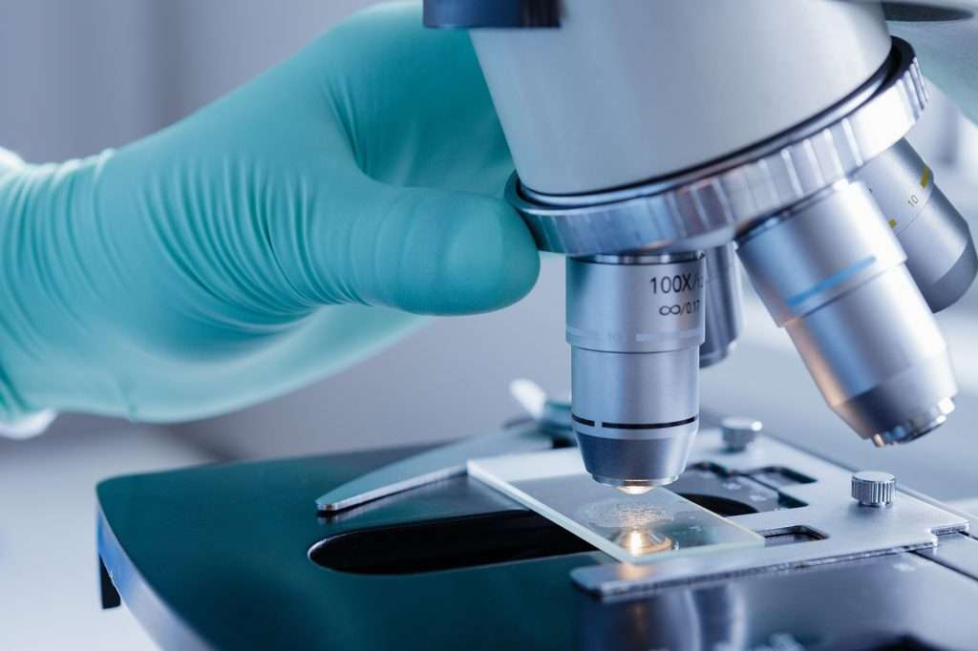
PROBLEM AND MOTIVATION
Gold standard for disease diagnosis, especially in oncology.
Manual examination is labour-intensive, subjective, and inefficient in high-volume settings.
Deep learning (DL) automates histopathology with high accuracy.

Slide 5
KNOWLEDGE GAP

Slide 6
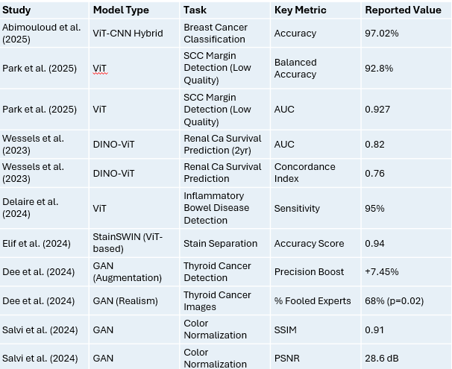
PERFORMANCE & COMPARISON
ViTs (Abimouloud, Park et al., 2025, Wessels et al, 2023)
GANs (Yan et al., 2025; Dee et al., 2024)
Lack of systemic comparison
Notes:
Abimouloud, M. L., Bensid, K., Elleuch, M., Ammar, M. B. and Kherallah, M. (2024) TokenMixer-ViT: Advancing breast cancer diagnosis with hybrid vision transformers. GitHub repository. Available at: https://github.com/author/tokenmixer-vit (Accessed: 15 June 2025).
Dee, W., Alaaeldin Ibrahim, R. and Marouli, E. (2024). Histopathological domain adaptation with generative adversarial networks: Bridging the domain gap between thyroid cancer histopathology datasets. PLOS ONE, 19(12), p.e0310417. doi: https://doi.org/10.1371/journal.pone.0310417.
Delaire, J., Yzet, C. et al. (2025) ‘ViT for inflammatory bowel disease’, Journal of Crohn’s and Colitis, 19(Suppl 1). doi: 10.1093/ecco-jcc/jjae190.0574.
Elif Baykal Kablan and Ayas, S. (2024). StainSWIN: Vision transformer-based stain normalization for histopathology image analysis. Engineering Applications of Artificial Intelligence, 133. doi: https://doi.org/10.1016/j.engappai.2024.108136.
Park, S.Y., Ayana, G., Wako, B.D., Jeong, K.C., Yoon, S.D. and Choe, S.W. (2025). Vision Transformers for Low-Quality Histopathological Images: A Case Study on Squamous Cell Carcinoma Margin Classification. Diagnostics, 15(3), p.260. doi: 10.3390/diagnostics15030260.
Salvi, M., Branciforti, F., Molinari, F. and Meiburger, K.M. (2024). Generative models for color normalization in digital pathology and dermatology: Advancing the learning paradigm. doi: https://doi.org/10.1016/j.eswa.2023.123105.
Wessels, F. et al. (2023). A self-supervised vision transformer to predict survival from histopathology in renal cell carcinoma. World Journal of Urology, 41(8), pp.2233–2241. doi: 10.1007/s00345-023-04489-7.
Yan, B., Wen, Z. and Jing, R. (2025) ‘GAN-generated H&E from Raman imaging’, International Journal of Oral Science, 17(1). doi: 10.1038/s41368-025-00346-y.

Slide 7
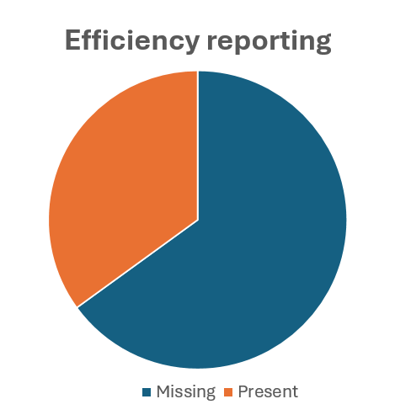
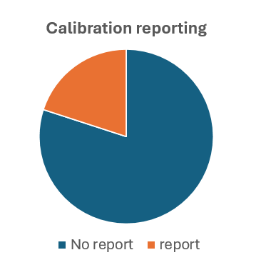
METHODOLOGY DEFICIENCIES
Reproducibility crisis (Salvi et al., 2024)
Incomplete evaluation (Salvi and Dee et al., 2024)(Park et al., 2025;Wessels et al., 2023)
Persistent technical challenges
Notes:
Dee, W., Alaaeldin Ibrahim, R. and Marouli, E. (2024). Histopathological domain adaptation with generative adversarial networks: Bridging the domain gap between thyroid cancer histopathology datasets. PLOS ONE, 19(12), p.e0310417. doi: https://doi.org/10.1371/journal.pone.0310417.
Park, S.Y., Ayana, G., Wako, B.D., Jeong, K.C., Yoon, S.D. and Choe, S.W. (2025). Vision Transformers for Low-Quality Histopathological Images: A Case Study on Squamous Cell Carcinoma Margin Classification. Diagnostics, 15(3), p.260. doi: 10.3390/diagnostics15030260.
Salvi, M., Branciforti, F., Molinari, F. and Meiburger, K.M. (2024). Generative models for color normalization in digital pathology and dermatology: Advancing the learning paradigm. doi: https://doi.org/10.1016/j.eswa.2023.123105.
Wessels, F. et al. (2023). A self-supervised vision transformer to predict survival from histopathology in renal cell carcinoma. World Journal of Urology, 41(8), pp.2233–2241. doi: 10.1007/s00345-023-04489-7.

Slide 8
HOW DO VISION TRANSFORMERS (VITS) VERSUS GAN APPROACHES SYSTEMATICALLY COMPARE FOR BREAST CANCER SUBTYPE CLASSIFICATION ON TCGA-BRCA.

Slide 9
OBJECTIVES
Systematic and reproducible comparison
Comprehencive evaluation framework
GANs in addressing data challenges
Full reproducibility
Evidence-based recommendation

Slide 10
METHODOLOGY
My Strategy

Slide 11

Dataset selection & Preparation
TCGA-BRCA
Justification (Mansour et al., 2025)
Addressing limitations ( Elif et al., 2024)
Data Handling
Notes:
Elif Baykal Kablan and Ayas, S. (2024). StainSWIN: Vision transformer-based stain normalization for histopathology image analysis. Engineering Applications of Artificial Intelligence, 133. doi: https://doi.org/10.1016/j.engappai.2024.108136.
Guo, X., Li, Y. and Wang, H. (2024) ‘Multi-scale hierarchical vision transformers for gastric cancer classification’, Medical Image Analysis, 103025. doi: 10.1016/j.media.2024.103025.
Mansour, A. M. A. et al. (2025) ‘MammoViT for BIRADS classification’, Diagnostics, 15(3), p. 285. doi: 10.3390/diagnostics15030285.

Slide 12


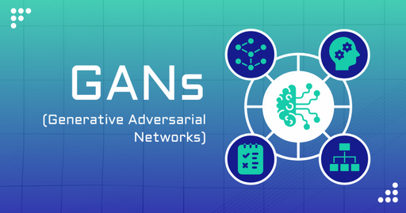

MODEL IMPLEMENTATION
Baseline ViT
(Wessels et al., 2023; Park et al., 2025)
GAN-Augmented ViT
Gan for Augmentation
(Ravi and Matt et al., 2025)
Hybrid
(Mansour et al., 2024)
Notes:
Mansour, A. M. A. et al. (2025) ‘MammoViT for BIRADS classification’, Diagnostics, 15(3), p. 285. doi: 10.3390/diagnostics15030285.
Park, S.Y., Ayana, G., Wako, B.D., Jeong, K.C., Yoon, S.D. and Choe, S.W. (2025). Vision Transformers for Low-Quality Histopathological Images: A Case Study on Squamous Cell Carcinoma Margin Classification. Diagnostics, 15(3), p.260. doi: 10.3390/diagnostics15030260.
Wessels, F. et al. (2023). A self-supervised vision transformer to predict survival from histopathology in renal cell carcinoma. World Journal of Urology, 41(8), pp.2233–2241. doi: 10.1007/s00345-023-04489-7.
Ravi, Chaitra & Matt, Siddesh. (2025). IC-CGAN: Imbalanced class-conditional generative adversarial network with weighted loss function. International Journal of Electrical and Computer Engineering (IJECE). 15. 1632. 10.11591/ijece.v15i2.pp1632-1646.

Slide 13
TRAINING & REPRODUCIBILITY
FULL TRANSPARANCY
ADDRESSING INSTABILITY
(Dee et al., 2024)
OPEN SOURCE
ENVIRONMENT
Notes:
Dee, W., Alaaeldin Ibrahim, R. and Marouli, E. (2024). Histopathological domain adaptation with generative adversarial networks: Bridging the domain gap between thyroid cancer histopathology datasets. PLOS ONE, 19(12), p.e0310417. doi: https://doi.org/10.1371/journal.pone.0310417.

Slide 14
COMPREHENSIVE EVALUATION FRAMEWORK
TASK PERFORMANCE
COMPUTATIONAL EFFICIENCY
CLINICAL RELEVANCE PROXIES
(Salvi and Dee et al., 2024; Park et al., 2025)
(Wessels et al., 2023)
GAN QUALITY
ROBUSTNESS
Notes:
Dee, W., Alaaeldin Ibrahim, R. and Marouli, E. (2024). Histopathological domain adaptation with generative adversarial networks: Bridging the domain gap between thyroid cancer histopathology datasets. PLOS ONE, 19(12), p.e0310417. doi: https://doi.org/10.1371/journal.pone.0310417.
Park, S.Y., Ayana, G., Wako, B.D., Jeong, K.C., Yoon, S.D. and Choe, S.W. (2025). Vision Transformers for Low-Quality Histopathological Images: A Case Study on Squamous Cell Carcinoma Margin Classification. Diagnostics, 15(3), p.260. doi: 10.3390/diagnostics15030260.
Salvi, M., Branciforti, F., Molinari, F. and Meiburger, K.M. (2024). Generative models for color normalization in digital pathology and dermatology: Advancing the learning paradigm. doi: https://doi.org/10.1016/j.eswa.2023.123105.
Wessels, F. et al. (2023). A self-supervised vision transformer to predict survival from histopathology in renal cell carcinoma. World Journal of Urology, 41(8), pp.2233–2241. doi: 10.1007/s00345-023-04489-7.

Slide 15

TIMELINE
SETUP, LITERATURE REVIEW, DATA ACQUISITION
BASELINE & GAN TRAINING
EVALUATION & ANALYSIS
1
3
5
2
4
6
DATA PREP & INITIAL MODEL IMPLEMENTATION
COMPARATIVE MODEL TRAINING & EXPERIMENTS
WRITE-UP & DISSEMINATION PREP

Slide 16
EXPECTED OUTCOMES
&
SIGNIFICANCE

Slide 17
PUBLICLY AVAILABLE AND DOCUMENTED
SYSTEMIC, REPRODUCIBLE BENCHMARK
ADDRESSING METHODOLOGY PITFALLS
OUTCOMES &
SIGNIFICANCE
PRACTIVAL, EVIDENCE-BASED GUIDELINES
CLEAR QUANTITATIVE EVIDENCE

Slide 18
ETHICAL CONSIDERATIONS
CONDUCT RESEARCH RESPONSIBLY
PUBLICBLY AVAILABLE DATA
(Wessels et al., 2023)
FAIRNESS AND BIAS
TRANSPARENCY
(Salvi et al., 2024)
(Dee et al., 2024)
Notes:
Dee, W., Alaaeldin Ibrahim, R. and Marouli, E. (2024). Histopathological domain adaptation with generative adversarial networks: Bridging the domain gap between thyroid cancer histopathology datasets. PLOS ONE, 19(12), p.e0310417. doi: https://doi.org/10.1371/journal.pone.0310417.
Salvi, M., Branciforti, F., Molinari, F. and Meiburger, K.M. (2024). Generative models for color normalization in digital pathology and dermatology: Advancing the learning paradigm. doi: https://doi.org/10.1016/j.eswa.2023.123105.
Wessels, F. et al. (2023). A self-supervised vision transformer to predict survival from histopathology in renal cell carcinoma. World Journal of Urology, 41(8), pp.2233–2241. doi: 10.1007/s00345-023-04489-7.

Slide 19
CONCLUSION
Towards Reliable AI in Histopathology

Slide 20
CONCLUSION
IMRPOVE PATIENT CARE
PROMISING FOR HISTOPATHOLOGY
GOAL OF
RESEARCH
GAPS IN RESEARCH
AIM OF PROPOSAL
ADDRESSING GAPS

Slide 21
REFERENCES:
Abimouloud, MAbimouloud, M. L., Bensid, K., Elleuch, M., Ammar, M. B. and Kherallah, M. (2024) TokenMixer-ViT: Advancing breast cancer diagnosis with hybrid vision transformers. GitHub repository. Available at: https://github.com/author/tokenmixer-vit (Accessed: 15 June 2025).
Chaurasia, A. K., Toohey, P. W., Harris, H. C., & Hewitt, A. W. (2025). Multi-resolution vision transformer model for skin cancer subtype classification using histopathology slides. https://doi.org/10.1101/2025.01.28.25321234
Chen, L., Zhang, W. and Huang, F. (2024) ‘GAN-based virtual staining for frozen sections’, Nature Digital Medicine, 3(1). doi: 10.1038/s44287-023-00012-7.
Dee, W., Alaaeldin Ibrahim, R. and Marouli, E. (2024). Histopathological domain adaptation with generative adversarial networks: Bridging the domain gap between thyroid cancer histopathology datasets. PLOS ONE, 19(12), p.e0310417. doi: https://doi.org/10.1371/journal.pone.0310417.
Delaire, J., Yzet, C. et al. (2025) ‘ViT for inflammatory bowel disease’, Journal of Crohn’s and Colitis, 19(Suppl 1). doi: 10.1093/ecco-jcc/jjae190.0574.
Eghbali, N. and Ghassemi, M. M. (2025) GLoG-CSUnet: Radiomic-enhanced ViTs. arXiv. Available at: arXiv:2501.02788.
Elif Baykal Kablan and Ayas, S. (2024). StainSWIN: Vision transformer-based stain normalization for histopathology image analysis. Engineering Applications of Artificial Intelligence, 133. doi: https://doi.org/10.1016/j.engappai.2024.108136.
Guo, X., Li, Y. and Wang, H. (2024) ‘Multi-scale hierarchical vision transformers for gastric cancer classification’, Medical Image Analysis, 103025. doi: 10.1016/j.media.2024.103025.
Maheriya, K., Ganatra, A. et al. (2025) ‘XAI-ViT for prostate cancer’, Artificial Intelligence in Oncology. doi: 10.1201/9781032626345-12.
Mansour, A. M. A. et al. (2025) ‘MammoViT for BIRADS classification’, Diagnostics, 15(3), p. 285. doi: 10.3390/diagnostics15030285.
Mouhamed Laid Abimouloud, Khaled Bensid, Elleuch, M., Ammar, M.B. and Monji Kherallah (2025). Advancing breast cancer diagnosis: token vision transformers for faster and accurate classification of histopathology images. Visual Computing for Industry Biomedicine and Art, 8(1). doi:https://doi.org/10.1186/s42492-024-00181-8.
Park, S.Y., Ayana, G., Wako, B.D., Jeong, K.C., Yoon, S.D. and Choe, S.W. (2025). Vision Transformers for Low-Quality Histopathological Images: A Case Study on Squamous Cell Carcinoma Margin Classification. Diagnostics, 15(3), p.260. doi: 10.3390/diagnostics15030260.
Ravi, Chaitra & Matt, Siddesh. (2025). IC-CGAN: Imbalanced class-conditional generative adversarial network with weighted loss function. International Journal of Electrical and Computer Engineering (IJECE). 15. 1632. 10.11591/ijece.v15i2.pp1632-1646.
Saad, A., Ghatwary, N. and El-Mahallawy, M. S. (2025) ‘IHC-GAN: H&E-to-IHC translation’, BMC Medical Imaging, 25(1). doi: 10.1186/s12880-024-01522-y.
Salvi, M., Branciforti, F., Molinari, F. and Meiburger, K.M. (2024). Generative models for color normalization in digital pathology and dermatology: Advancing the learning paradigm. doi: https://doi.org/10.1016/j.eswa.2023.123105.
Springenberg, M., Frommholz, A., Wenzel, M., Weicken, E., Ma, J., & Strodthoff, N. (2023). From modern CNNs to vision transformers: Assessing the performance, robustness, and classification strategies of deep learning models in histopathology. Medical Image Analysis, 87, 102809. https://doi.org/10.1016/j.media.2023.102809
Sun, S., Tessier, L. and Baumgartner, C. F. (2025) Label-free vision transformers for gigapixel histopathology. arXiv preprint. Available at: arXiv:2501.02922.
Von Wangenheim, A. and Pereira, R. (2024) A systematic review of vision transformers in histopathology. ResearchGate. Available at: https://www.researchgate.net/publication/383231612 (Accessed: 15 June 2025).
Wang, T. and Li, J. (2025) ‘Grad-Attn ViT for lymph node metastasis’, Expert Systems with Applications, 122786. doi: 10.1016/j.eswa.2025.122786.
Wessels, F. et al. (2023). A self-supervised vision transformer to predict survival from histopathology in renal cell carcinoma. World Journal of Urology, 41(8), pp.2233–2241. doi: 10.1007/s00345-023-04489-7.
Yan, B., Wen, Z. and Jing, R. (2025) ‘GAN-generated H&E from Raman imaging’, International Journal of Oral Science, 17(1). doi: 10.1038/s41368-025-00346-y.

Slide 22
THANK YOU

